Slide 1
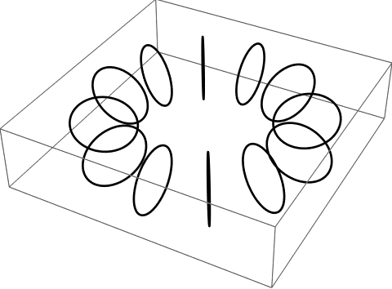
Torus

Slide 2
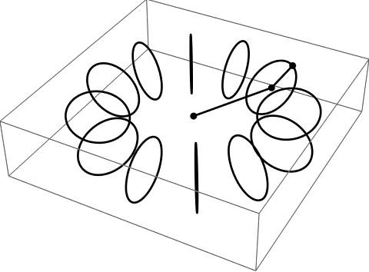
Torus

Slide 3
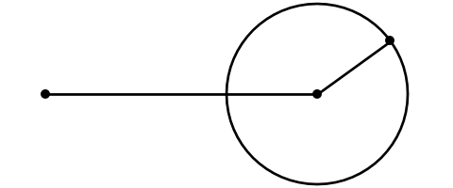
Torus

Slide 4
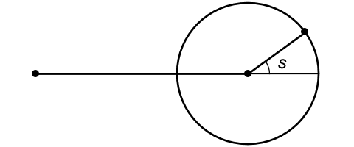
Torus

Slide 5
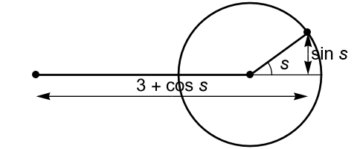
Torus

Slide 6
Torus

Slide 7
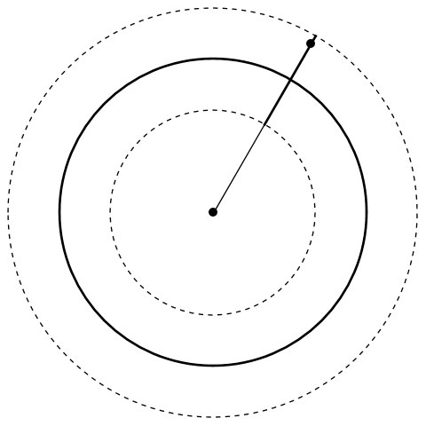
Torus

Slide 8
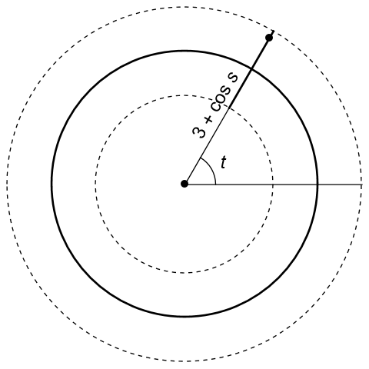
Torus

Slide 9

Torus
$$x=\left(3+\cos{s}\right)\cos{t}$$
$$y=\left(3+\cos{s}\right)\sin{t}$$
$$z=\sin{s}$$

Slide 10
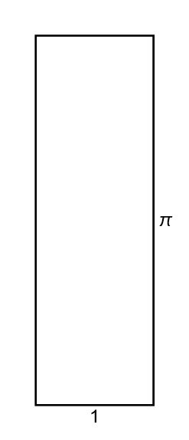
Continued Fraction

Slide 11
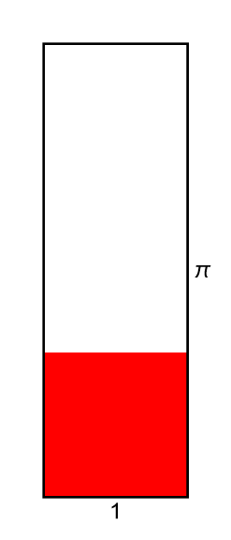
Continued Fraction

Slide 12
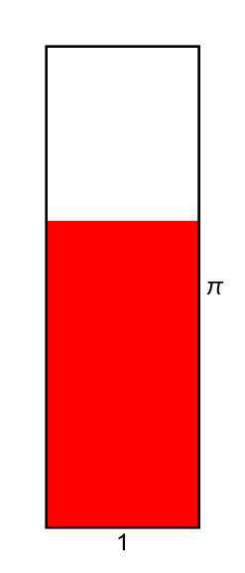
Continued Fraction

Slide 13
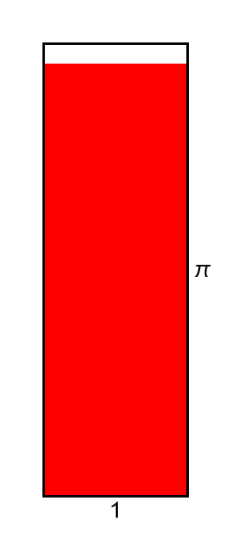
Continued Fraction

Slide 14
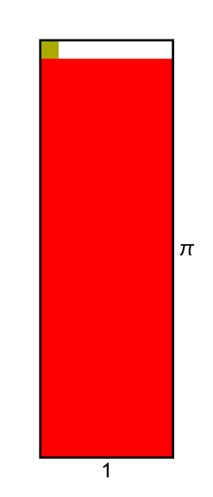
Continued Fraction

Slide 15
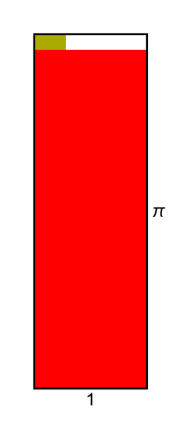
Continued Fraction

Slide 16
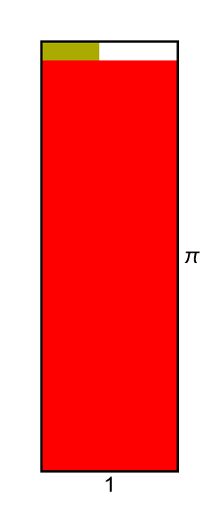
Continued Fraction

Slide 17
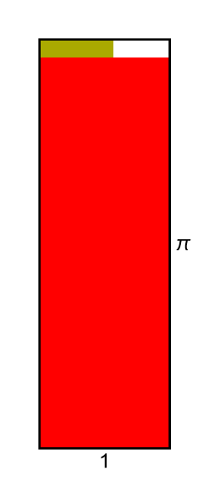
Continued Fraction

Slide 18
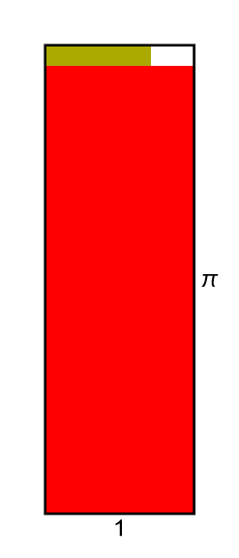
Continued Fraction

Slide 19
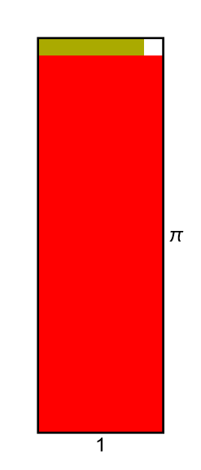
Continued Fraction

Slide 20
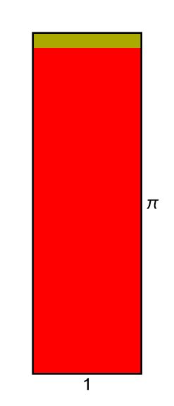
Continued Fraction

Slide 21
Continued Fraction

Slide 22
Continued Fraction

Slide 23
Continued Fraction

Slide 24
Continued Fraction

Slide 25
Continued Fraction

Slide 26
Continued Fraction

Slide 27
Continued Fraction

Slide 28
Continued Fraction

Slide 29
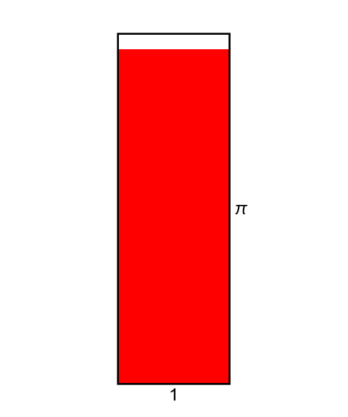
Continued Fraction

Slide 30
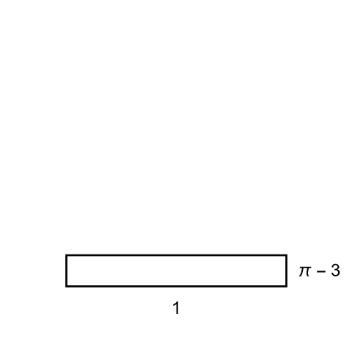
Continued Fraction

Slide 31

Continued Fraction

Slide 32
Continued Fraction

Slide 33
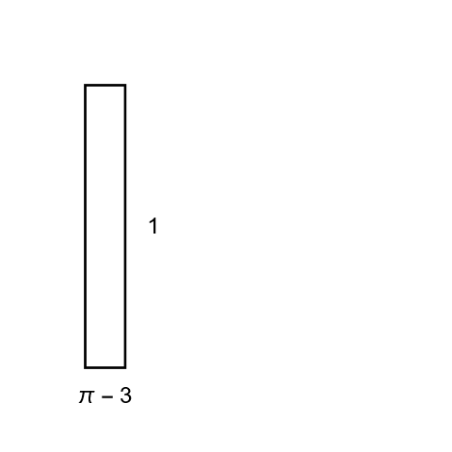
Continued Fraction

Slide 34
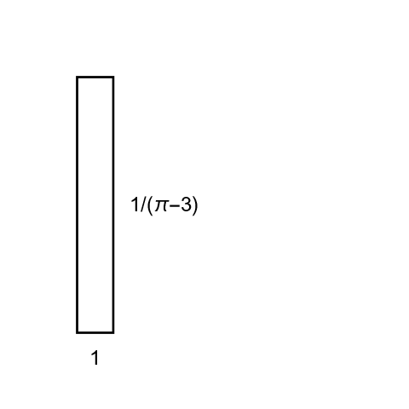
Continued Fraction

Slide 35
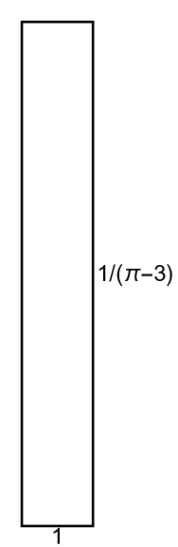
Continued Fraction

Slide 36
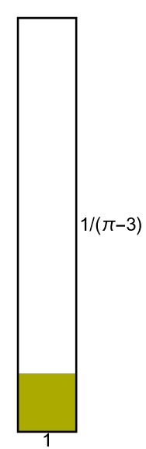
Continued Fraction

Slide 37
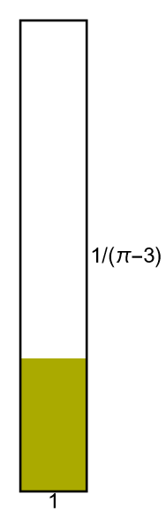
Continued Fraction

Slide 38
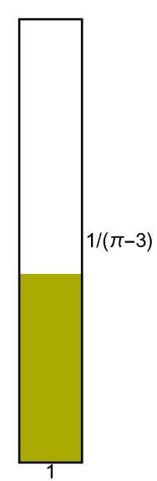
Continued Fraction

Slide 39
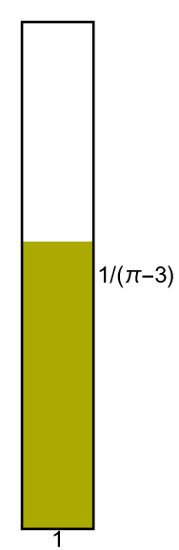
Continued Fraction

Slide 40
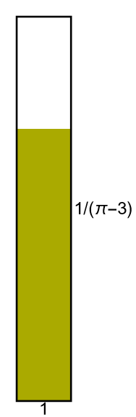
Continued Fraction

Slide 41
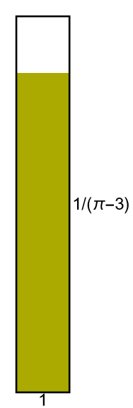
Continued Fraction

Slide 42
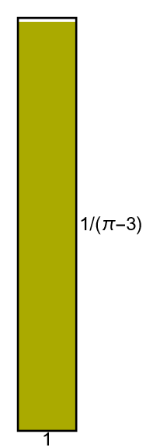
Continued Fraction

Slide 43
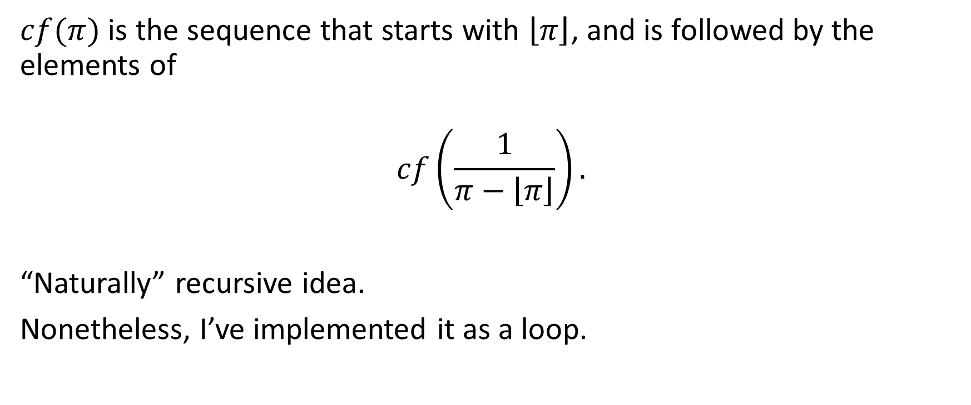
Continued Fraction
$cf(π)$ is the sequence that starts with $\left\lfloor π\right\rfloor$, and is followed by the elements of
$$cf\left(\frac{1}{π−\left\lfloor π\right\rfloor }\right).$$
“Naturally” recursive idea.
Nonetheless, I’ve implemented it as a loop.

Slide 44

Continued Fraction in reverse
$cf^{−1}(seq)$ is the first element of $seq$, added to the reciprocal of $cf^{−1}$ of the rest of $seq$.
Also “naturally” recursive.
Let’s do this one recursively.

